Slide 1




















MUSIC aPPliCATION

Slide 2
















































































TEAM MEMBER
CHANDRIKI TIWARI
(2200290140049)
Project Mentor
Ms Shalika Arora

Slide 3


INTRODUCTION
Today, music is predominantly consumed via mobile devices, facilitated by streaming services like Spotify and Music Player. These platforms offer unlimited access to a vast library of songs without the need for ownership. By signing up and linking social media accounts, users can enjoy personalized playlists and discover new tracks effortlessly.

Slide 4

INTRODUCTION
These platforms provide unparalleled access to an extensive catalog of songs, eliminating the need for traditional ownership models. By seamlessly integrating with social media, they offer personalized experiences, revolutionizing how people discover and enjoy music.

Slide 5





























Technology Used
React
Redux
Tailwind

Slide 6
MODULES
Home Page
Music Player
Lyrics Display
Search
Song Exploration Feature

Slide 7
KEY FEATURES
Play Music
Pause Music
Stop Music
Rewind Music and can Shuffle song
Search by Artists or by Song
Previous or Next Song feature
Repeat

Slide 8
HARDWARE USED
Storage
Internet Connectivity
OS

Slide 9
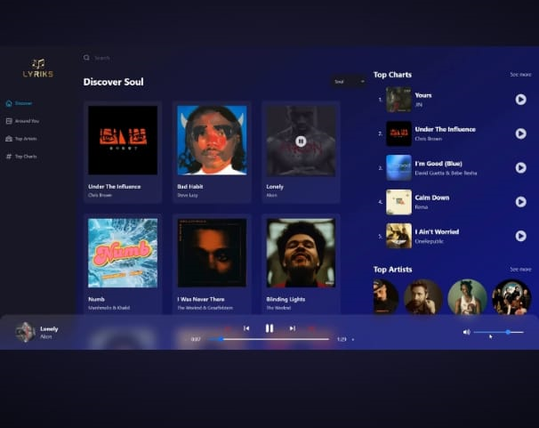
OUTPUT
1. Image to sketch

Slide 10
CONCLUSION
The music app project has successfully delivered a modern and feature-rich application tailored to the needs of music enthusiasts. With a sleek homepage design, a fully-fledged music player, comprehensive search functionality, synchronized lyrics display, and engaging song exploration features, the app offers a seamless and immersive music listening experience..

Slide 11


